Slide 1
Deep Learning for Generic Object Detection: A Survey

Slide 2
Content
1, Introduce
2, Datasets , Evaluation Criteria
3, Frameworks
4, Object Representation
5, Context Modeling
6, Detection Proposal Methods
7, Other Issues
8, Discussion and Conclusion

Slide 3
Generic object detection
Generic object detection : return the spatial location and extent of each instance

Slide 4
Generic object detection
Notes:
A；判断图片中有多少类目标
B；用长方形目标框标识出各个目标
C:像素级识别图片中的目标类，每个像素属于哪种类别的目标
D:在c基础上，还要能区分同一类的不同个体

Slide 5
Generic object detection
high efficiency
VS
accuracy
Notes:
准确率挑战：
1，类内差异：类内不同个体有差异，成像条件也有不同，还有噪音
2，类间差异：不同类别可能相似；自然界物种太多了，像图像识别任务才用了1000类
精确度：
移动计算，图像尺寸

Slide 6
Generic object detection
Notes:
上面是椅子的各种表现形式
下面是四种类别，但是非常相似！

Slide 7
Generic object detection
Notes:
SIFT之前是用整体特征：基于目标整体形状匹配-----》基于外观特征，使用统计分类器分类
SIFT开始使用局部特征，并且考虑了局部特征的旋转平移不变性，（把图片模糊处理，和原图对比，差别大的地方定义为特征点，用于匹配，在特征点周围定义一个正方形，
做网格划分，展成一维向量，并且对向量做旋转缩放等操作，形成最后的具有不变性的特征向量）
下一个关键点：alexnet（cnn网络），全部交给网络处理

Slide 8
Content
1, Introduce
2, Datasets , Evaluation Criteria
3, Frameworks
4, Object Representation
5, Context Modeling
6, Detection Proposal Methods
7, Other Issues
8, Discussion and Conclusion

Slide 9
Datasets
the most representative models of deep learning：
Convolutional Neural Networks (CNNs)
four famous datasets:
1，PASCAL VOC
2，ImageNet（Large Scale）
3，MS COCO（ complex everyday scenes）
4，Open Images（largest）
Notes:
Imagenet种类数量更多，但是图像比较规则，目标一般在图片中心，ms coco克服了这个问题
Open,前面的标记都是雇人手动标记，这个是首先图像识别后给出很多label，所以标记更复杂，且有一定的不可靠。对于验证集测试集还要人工确认

Slide 10
Datasets
Notes:
Imagenet种类数量更多，但是图像比较规则，目标一般在图片中心，ms coco克服了这个问题
Open,前面的标记都是雇人手动标记，这个是首先图像识别后给出很多label，所以标记更复杂，且有一定的不可靠。对于验证集测试集还要人工确认

Slide 11
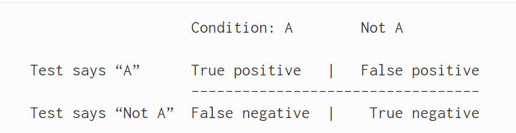
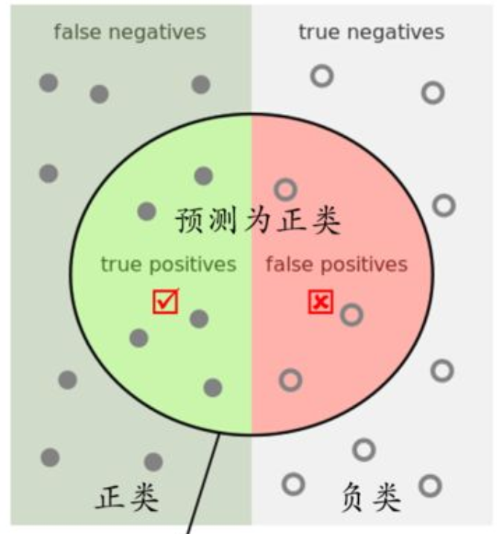
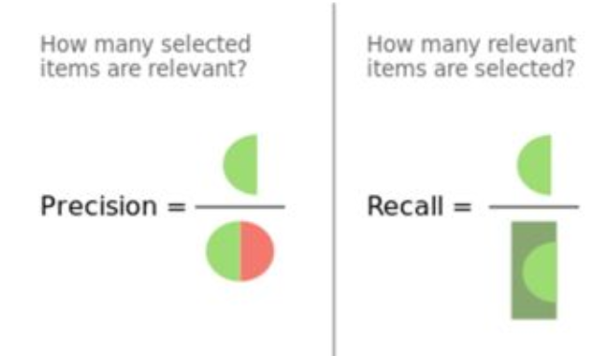
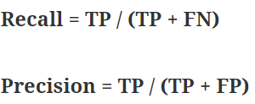
Evaluation Criteria
three criteria for evaluating the performance：
1，detection speed in Frames Per Second (FPS)
2，precision
3，recall

Slide 12
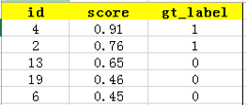
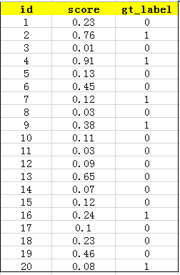
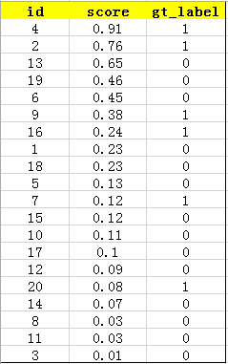
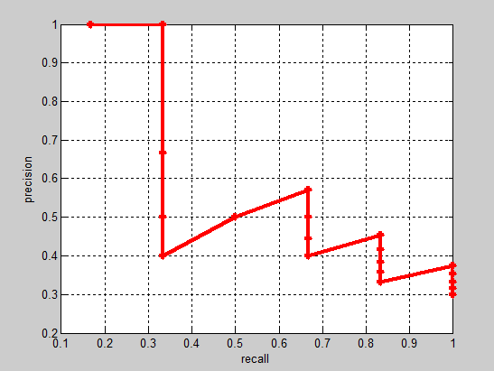
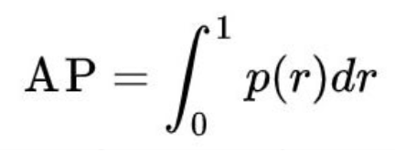
Evaluation Criteria
true positives
Such as TOP5
positives
false positives
Notes:
一个极端的例子是：如果把所有样本都判为正样本，那个precision就会很小，而recall此时达到最大为1；相反地如果只把极少数的样本判为正样本，那么可能能得到很高的precision，而结果不够完整。
ap这个指标则很好的兼顾了两者。可以将它看成precision/recall曲线下方围成的曲面面积
Score判断类别为1的概率，gt_label表示groundtruth_label真实值

Slide 13
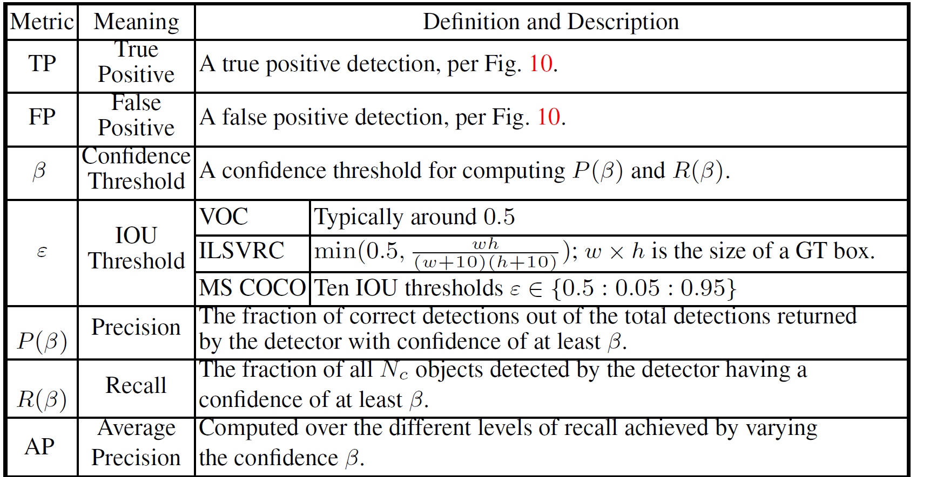
Evaluation Criteria
Notes:
AP衡量的是学出来的模型在每个类别上的好坏，mAP衡量的是学出的模型在所有类别上的好坏，得到AP后mAP的计算就变得很简单了，就是取所有AP的平均值。

Slide 14
Content
1, Introduce
2, Datasets , Evaluation Criteria
3, Frameworks
4, Object Representation
5, Context Modeling
6, Detection Proposal Methods
7, Other Issues
8, Discussion and Conclusion

Slide 15
Frameworks
detection frameworks:
1, Two stage detection frameworks, which include a preprocessing Step for generating object proposals;
2, One stage detection frameworks, or region proposal free
frameworks, having a single proposed method which does not
separate the process of the detection proposal.

Slide 16
Region Based (Two Stage) Frameworks

Slide 17
Region Based (Two Stage) Frameworks
RCNN:
1, Region proposal computation via a selective search
2, CNN model fine-tuning
3, Class specific SVM classifiers training
4, Class specific bounding box regressor training
Notes:
计算量大

Slide 18
Region Based (Two Stage) Frameworks

Slide 19
Region Based (Two Stage) Frameworks

Slide 20
Region Based (Two Stage) Frameworks

Slide 21
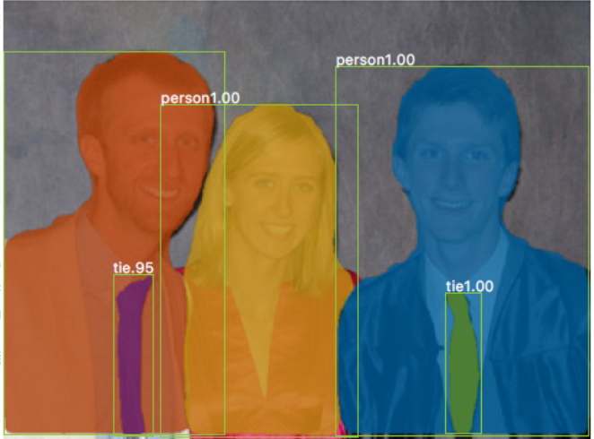
Region Based (Two Stage) Frameworks
Notes:
像素级实例分割
增加了一个mask层，输出K*m*m,原文是80*28*28，80代表一共80类，28*28表示每个目标框分成80*80像素级别，01二值输出掩码

Slide 22
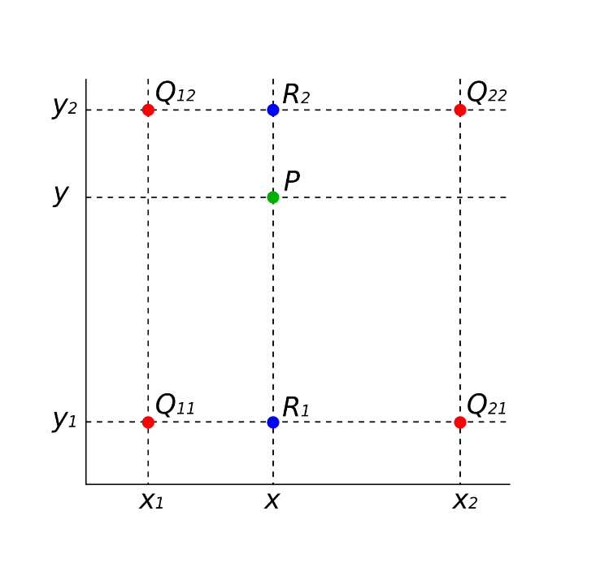
Region Based (Two Stage) Frameworks
ROIAlign
Bilinear interpolation
Notes:
第一步找出roi区域，第二步划分7*7网格
第一步如果原图像尺寸不能整除，就四舍五入，第二步同样可能四舍五入，精度损失
以划分2*2网格为例，内部再次分出4个中心，每个中心的值由周围四个点双线性插值得到，对四个点maxpool

Slide 23
Unified (One Stage) Frameworks

Slide 24
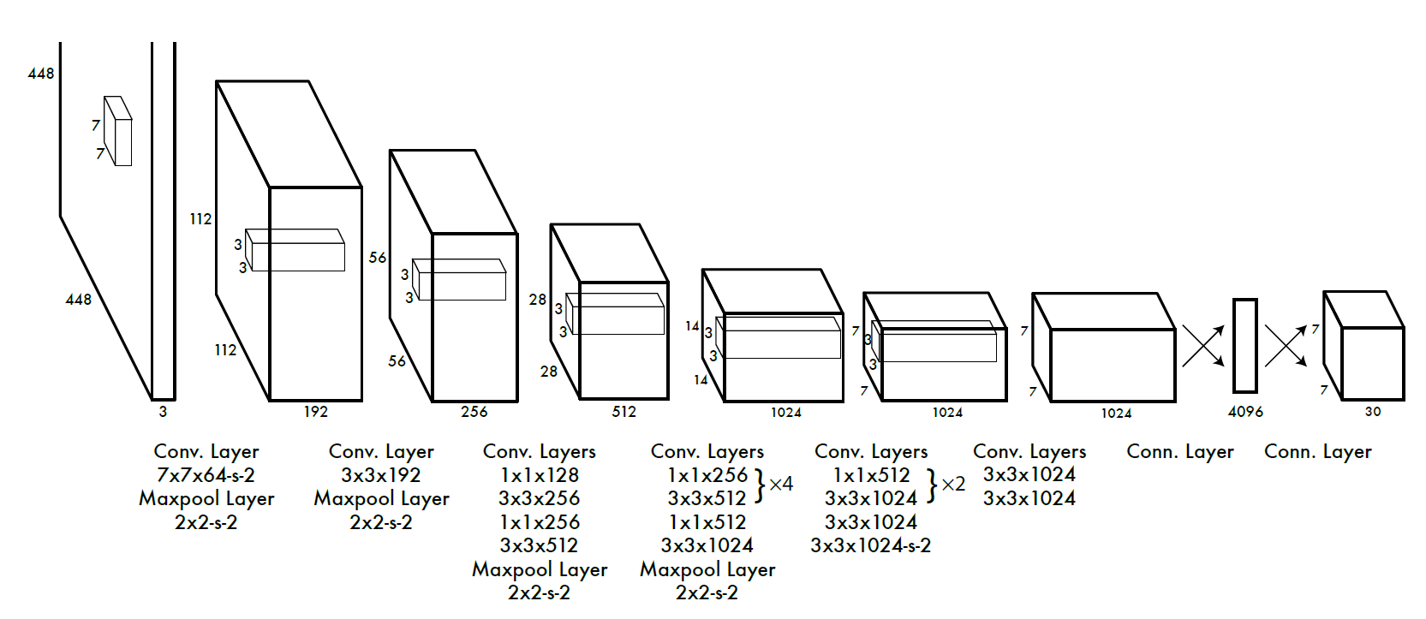
YOLO
Notes:
整个过程网络都能看到整张图片，也就是包含上下文，R-cnn只能看到proposal
不需要rpn过程，网络直接输出目标框，速度快
We use a linear activation function for the final layer and all other layers use the following leaky rectified linear acti-vation
448*448

Slide 25
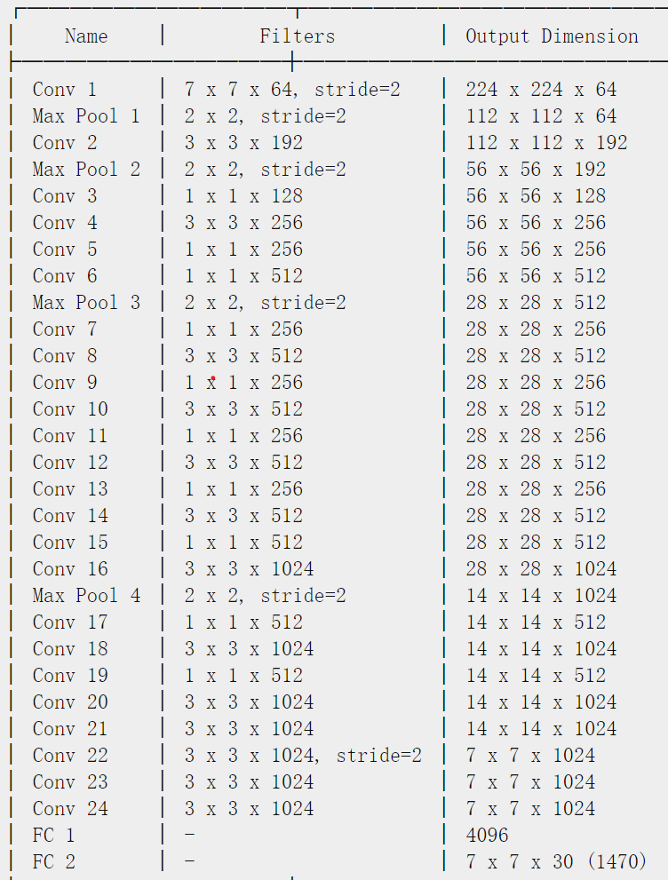
YOLO
Notes:
卷积后都接relu

Slide 26
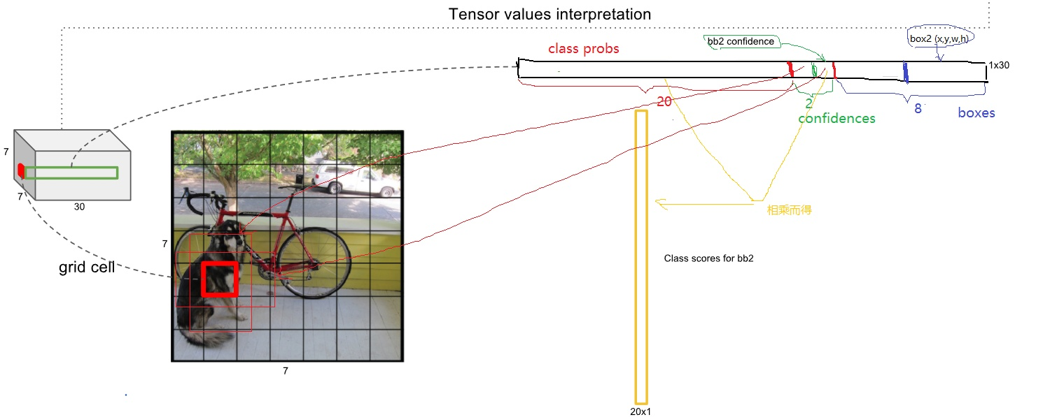
YOLO
Notes:
两个目标框只输出一组class Probs，也即是概率和anchor绑定，而不是检测框

Slide 27
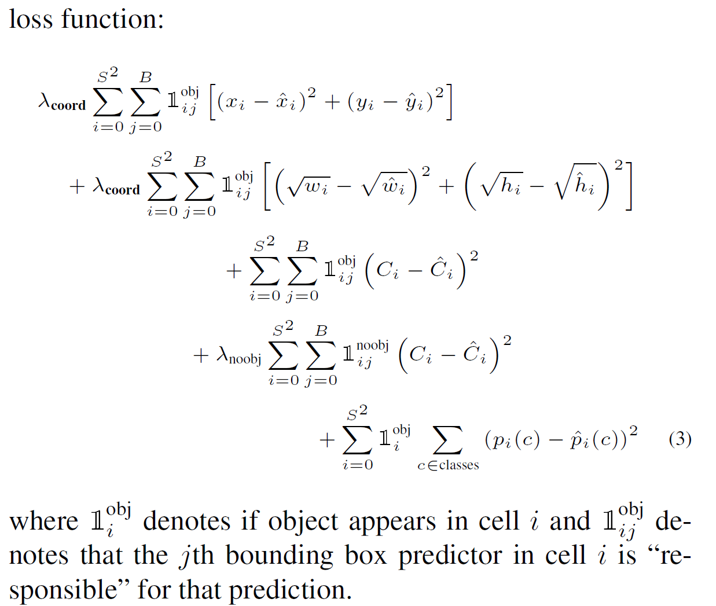
YOLO
Notes:
If no object exists in that cell, the confidence scores should be zero.
Otherwise we want the confidence score to equal the intersection over union (IOU) between the predicted box and the ground truth.
如果该单元格中没有对象，则置信度分数应为零。如果由对象，我们希望置信度分数等于预测框与地面实况之间的并集交集（IOU）。
在计算IOU误差时，包含物体的格子与不包含物体的格子，二者的IOU误差对网络loss的贡献值是不同的。若采用相同的权值，那么不包含物体的格子的confidence值近似为0，
变相放大了包含物体的格子的confidence误差在计算网络参数梯度时的影响。为解决这个问题，

Slide 28
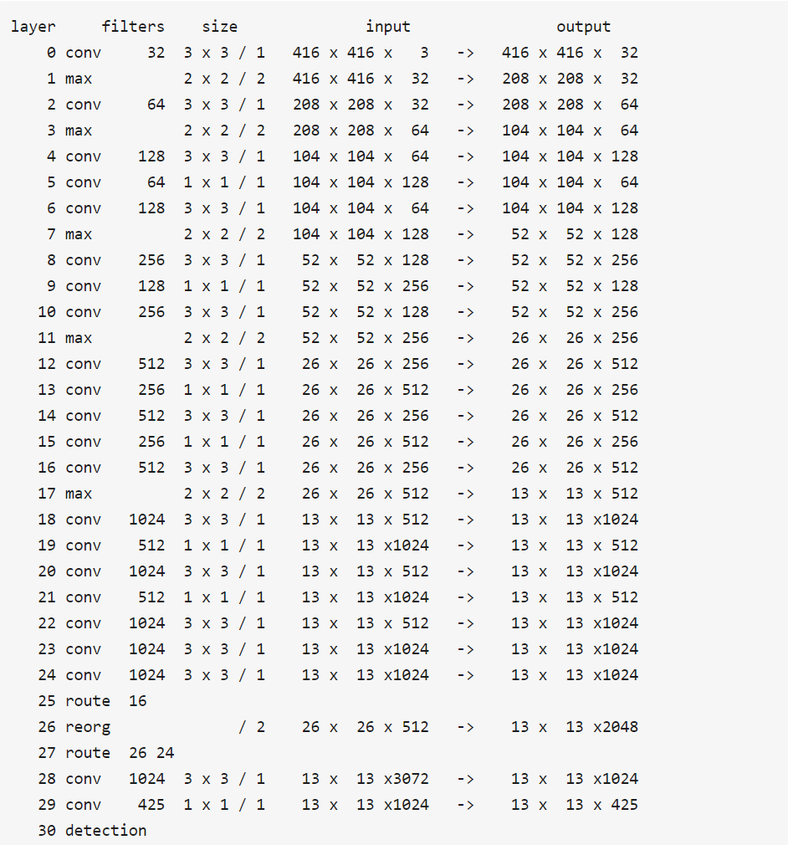
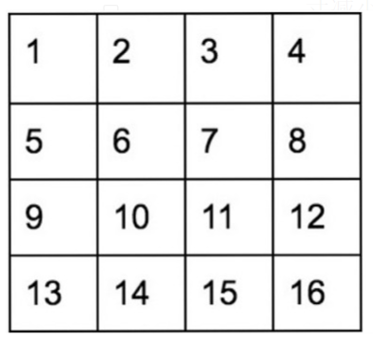
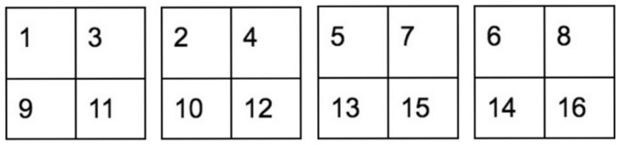
YOLO v2
Notes:
骨干网络卷积层变少，网络头部将全连接层变为卷积层，参数共享，总之就是减小网络结构
608*608

Slide 29
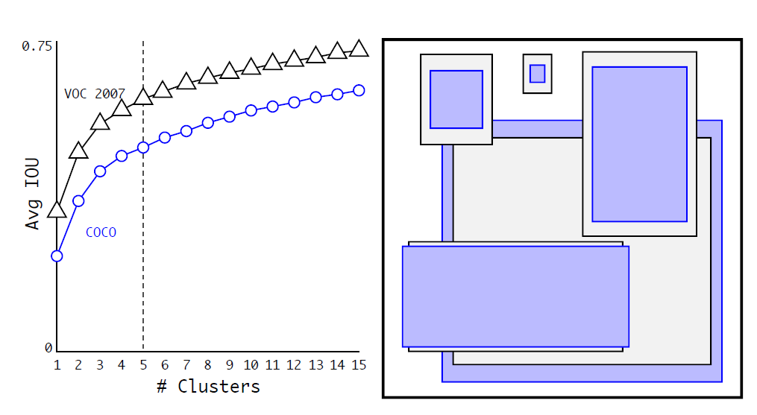
YOLO v2
Notes:
K-mean聚类，检测框的尺寸，拐点5
anchors = 0.57273, 0.677385, 1.87446, 2.06253, 3.33843, 5.47434, 7.88282, 3.52778, 9.77052, 9.16828

Slide 30
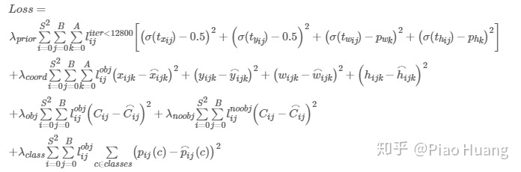
YOLO v2
Notes:
概率和检测框绑定
p代表的是anchor box的先验值，c表示每个网格区域的左上角顶点，t表示网络输出的目标框的5个参数(tx,ty,tw,th,to),b表示真实预测定位信息

Slide 31
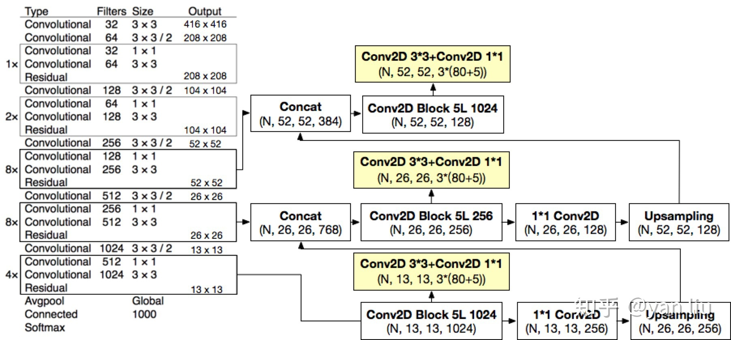
YOLO v3
Notes:
残差神经网络，FPN（三层）
608*608

Slide 32
YOLO nano
NetScore: Design Principles
Max NetScore subject to mean average precision (mAP) > 65%
Notes:
保证AP的情况下，score越大越好，在yolo网络的基础上修改

Slide 33
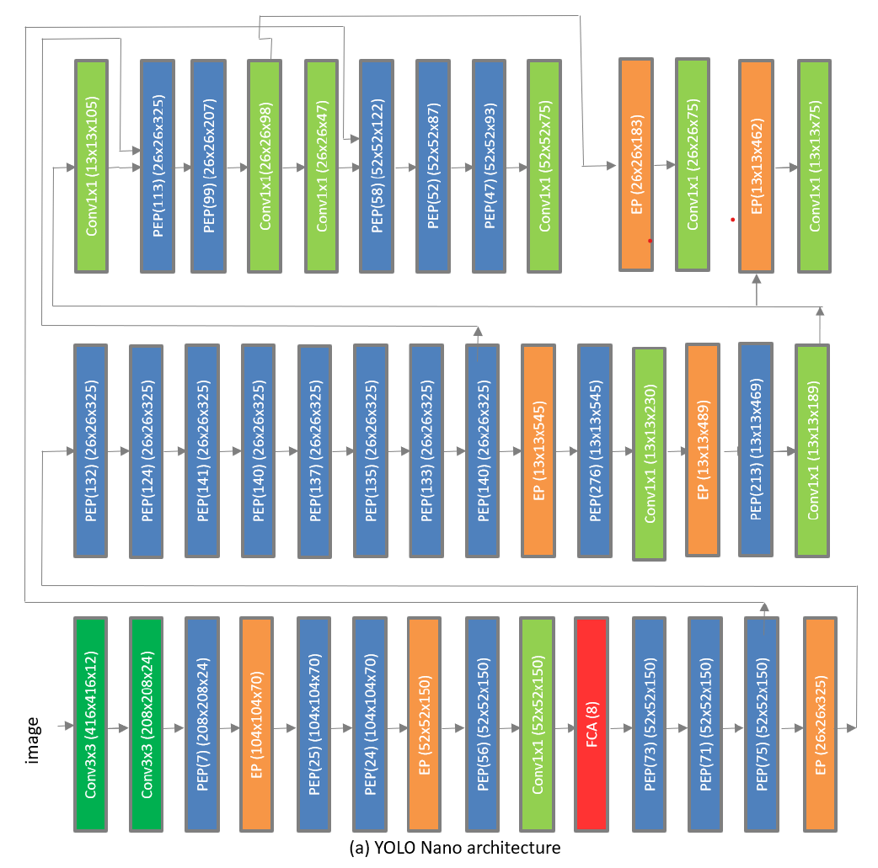
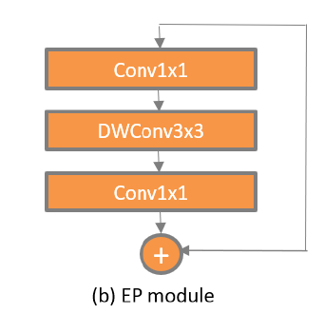
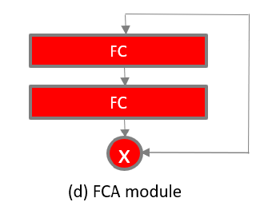
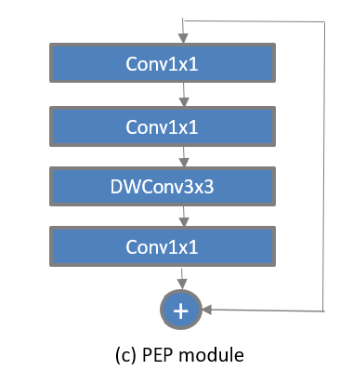
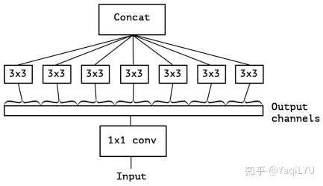
YOLO-nano
Notes:
人工设计三个基本模块，组合得到全部
PEP降维-升维-conv-降维到需要的channel数（降维后升维可以克服过拟合）
FCA层有加权效果，比相同维度普通FC层包含更多信息

Slide 34
Content
1, Introduce
2, Datasets , Evaluation Criteria
3, Frameworks
4, Object Representation
5, Context Modeling
6, Detection Proposal Methods
7, Other Issues
8, Discussion and Conclusion

Slide 35
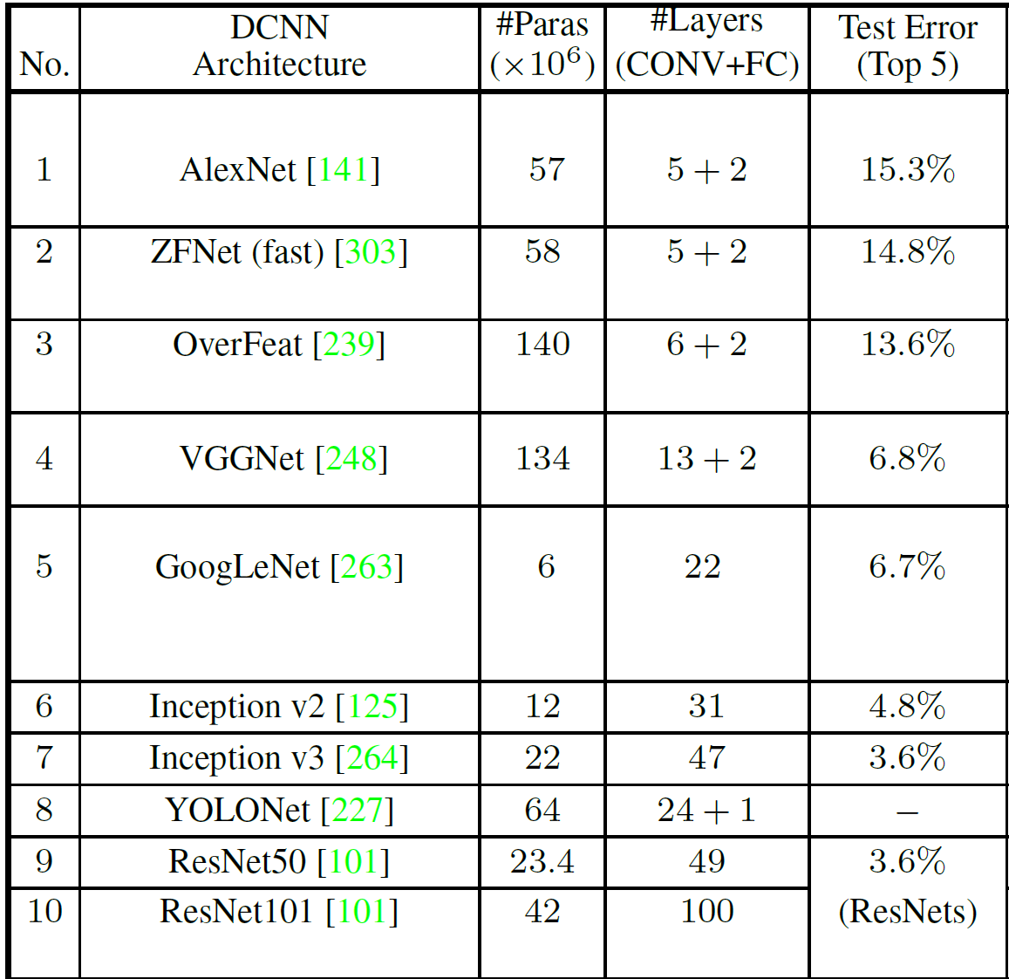
Object Representation
backbone network
（DCNN）
Notes:
各种cnn网络

Slide 36
Methods For Improving Object Representation
Handling of Object Scale Variations：
Detecting with combined features of multiple layers;
Detecting at multiple layers;
Combinations of the above two methods.(such as : FPN)
Handling of Other Intraclass Variations：
Geometric transformations,
Occlusions,
Image degradations: Image degradation is the act of loss of quality of an image due to different reasons
Notes:
抽象层次越高，越具有强大的语义能力，越不容易受对象的细节（姿态，亮度等）影响，意思也就是缺少细节。
层次越低，细节越多，分辨率越高
1，融合多层可以兼具语义和分辨率，不同的融合方式；2，低级特征分辨率高，适合小物体，高级特征适合大物体，甚至可以使用反卷积得到高分辨率特征图；
3，融合出多种尺寸特征，效果更好
类内差异：图像变形，遮挡，精度不足

Slide 37
Methods For Improving Object Representation
Notes:
不同的特征融合方式，不同的特征组合方式
反卷积：先上采样，升维，然后卷积，最后的维度

Slide 38
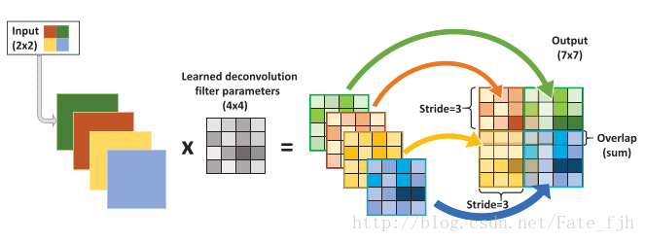
Methods For Improving Object Representation
deconvolution
Notes:
越来越复杂

Slide 39
Methods For Improving Object Representation
Handling of Other Intraclass Variations：
Geometric transformations,
Data Augmentation
Deformable Part based Models
Occlusions,
GAN
Image degradations: Image degradation is the act of loss of quality of an image due to different reasons
No answer
Notes:
集合变换：
可以数据增强，深度学习之前，传统方法，可变形部件，效果不如现代方法，单这种方法可以脱离物体的形变
对于cnn网络，maxpool层有一定的抗几何形变能力

Slide 40
Content
1, Introduce
2, Datasets , Evaluation Criteria
3, Frameworks
4, Object Representation
5, Context Modeling
6, Detection Proposal Methods
7, Other Issues
8, Discussion and Conclusion

Slide 41
Context Modeling
Semantic context: The likelihood of an object to be found in some scenes, but not in others;
Spatial context: The likelihood of finding an object in some position and not others with respect to other objects in the scene;
Scale context: Objects have a limited set of sizes relative to other objects in the scene.
Notes:
在某些场景中发现物体的可能性，而在另一些场景中则找不到
相对于场景中的其他对象，在某个位置找到一个对象而不是其他对象的可能性，客厅中茶几一般在客厅中央
相对于场景中的其他对象，对象具有一组有限的大小

Slide 42
Context Modeling
Global Context: refers to image or scene level contexts
Local context: considers the relationship among locally nearby objects, as well as the interactions between an object and its surrounding area. A simpler idea: enlarging the detection window size to extract some form of local context .
Notes:
Global，例如场景为卧室，出现床的概率比较高
Local, ：考虑附近物体之间的关系，以及物体与其周围区域之间的相互作用。

Slide 43
Content
1, Introduce
2, Datasets , Evaluation Criteria
3, Frameworks
4, Object Representation
5, Context Modeling
6, Detection Proposal Methods
7, Other Issues
8, Discussion and Conclusion

Slide 44
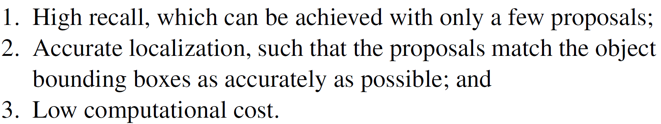
Detection Proposal Methods
Object proposals:

Slide 45
Detection Proposal Methods
Bounding Box Proposal Methods
Such as RPN
Object Segment Proposal Methods

Slide 46
Content
1, Introduce
2, Datasets , Evaluation Criteria
3, Frameworks
4, Object Representation
5, Context Modeling
6, Detection Proposal Methods
7, Other Issues
8, Discussion and Conclusion

Slide 47
Other Issues
Reducing Localization Error
Bounding boxes are only a crude approximation for articulated objects
Answer : MRCNN introduces iterative bounding box regression
Class Imbalance Handling
the serious imbalance between the number of labeled object instances and the number of background examples
Answer : the region proposal stage rapidly filters out most background regions and proposes a small number of object candidates

Slide 48
Content
1, Introduce
2, Datasets , Evaluation Criteria
3, Frameworks
4, Object Representation
5, Context Modeling
6, Detection Proposal Methods
7, Other Issues
8, Discussion and Conclusion

Slide 49
Discussion and Conclusion
Detection Frameworks: Two Stage vs One Stage
two-stage detectors generally produce higher detection accuracies than one-stage
One-stage SSD is less sensitive to the quality of the backbone network
One-stage detectors are generally faster than two-stage ones
Notes:
由于避免了预处理算法，因此使用轻量级的骨干网络，以较少的候选区域执行预测，并使分类子网完全卷积，所以速度快

Slide 50
Discussion and Conclusion
Research Directions
Compact and Efficient CNN Features
Better and More Efficient Detection Frameworks
Automatic Neural Architecture Search
Weakly Supervised Detection
Few / Zero Shot Object Detection
3D
Notes:
紧凑轻巧的骨干网络网络
弱监督学习，现有的数据集可能有错误，进一步的进展可能需要没有完全标记的数据，google数据集，

Slide 51
END

